Slide 1

Linear Regression Model For House Price Prediction
By,
Abhinava Tirumala Sai Ganesh
Student Id:02082182

Slide 2
Introduction
Objective:
The primary goal of this project is to develop a predictive model that can accurately forecast prices using linear regression. By leveraging a dataset with multiple attributes, the model aims to understand and quantify the relationships between various factors and price outcomes. This approach helps in making informed predictions that are essential for decision-making processes.
Importance:
Predictive modeling plays a crucial role across various industries, from real estate to finance and retail. In real estate, for instance, the ability to predict property prices can significantly impact investment decisions and market analyses. Similarly, in retail, price prediction models can optimize pricing strategies to maximize profits and competitiveness. By applying linear regression, this project not only contributes to academic understanding but also provides practical insights that can be implemented in real-world scenarios. The model’s predictions can assist businesses in strategizing their services or products according to predicted market trends, thereby enhancing operational efficiency and customer satisfaction.

Slide 3
Libraries Used
NumPy: Used for high-performance numerical computing and array operations.
pandas: Provides extensive tools for data manipulation and analysis.
matplotlib: Employed for creating static, interactive, and animated visualizations.
seaborn: Enhances matplotlib plots with improved aesthetics and additional plot types.
os: Handles file and directory operations, useful for navigating the project's file structure.
sklearn: A comprehensive library for machine learning, including tools for model building, evaluation, and preprocessing.
category_encoders: Offers advanced encoding techniques for categorical variables to improve model performance.
mean_absolute_error, mean_squared_error: Utilized for calculating error metrics to evaluate model accuracy.
mutual_info_regression: Assesses the dependency of target variables on input features for feature selection.
train_test_split, cross_val_score, GridSearchCV, LinearRegression, Pipeline, StandardScaler: Essential components for model preparation, evaluation, and optimization.

Slide 4
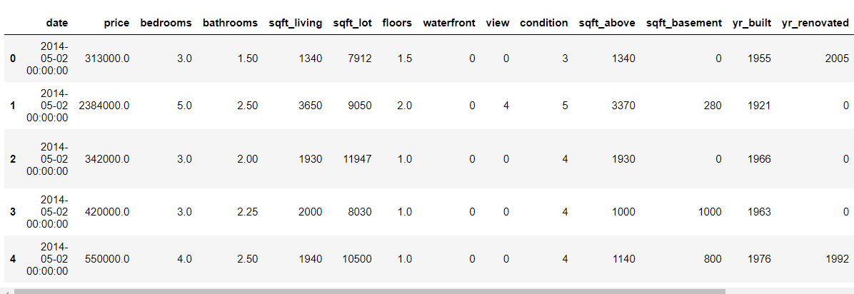
Dataset Overview
Source: The dataset is sourced from Kaggle, which hosts a wide variety of community-driven, rich datasets.
Purpose: This dataset is intended for building machine learning models capable of predicting housing prices from various property features.
Dimensions: (4600, 18)
Attributes: 'date', 'price', 'bedrooms', 'bathrooms', 'sqft_living', 'sqft_lot’, 'floors’ ,'waterfront', 'view', 'condition', 'sqft_above’, 'sqft_basement', 'yr_built’,'yr_renovated', 'street', 'city','statezip', 'country’.

Slide 5
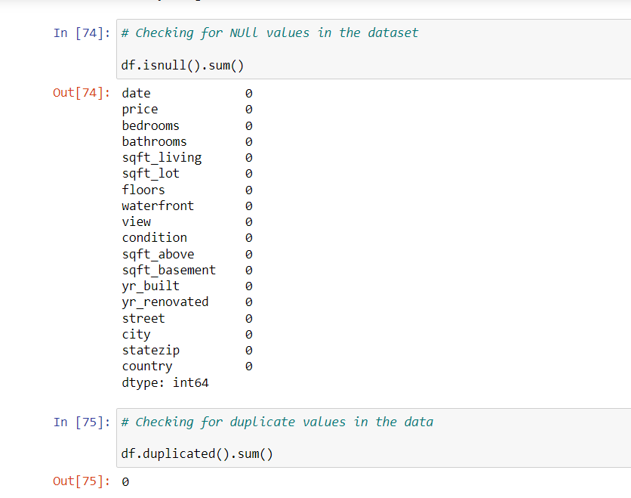
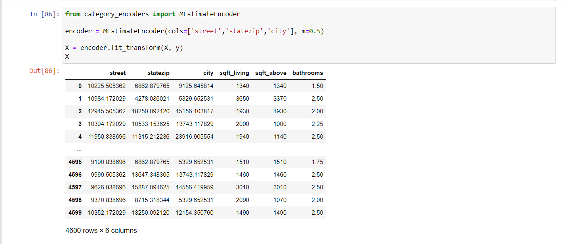
Data Pre-Processing
Cleaning Steps: The code checks for and handles missing values and duplicate records, ensuring the data quality is maintained for accurate model predictions. And We observed that there are no duplicate values and null values in the dataset.
Data Transformation: The dataset undergoes several transformations:
Encoding: Categorical variables such as 'street', 'statezip', and 'city' are encoded using the MEstimateEncoder to convert them into numerical values, which are more suitable for linear regression models.
Scaling: Data scaling is implemented as part of the model training pipeline using StandardScaler to standardize features by removing the mean and scaling to unit variance.

Slide 6
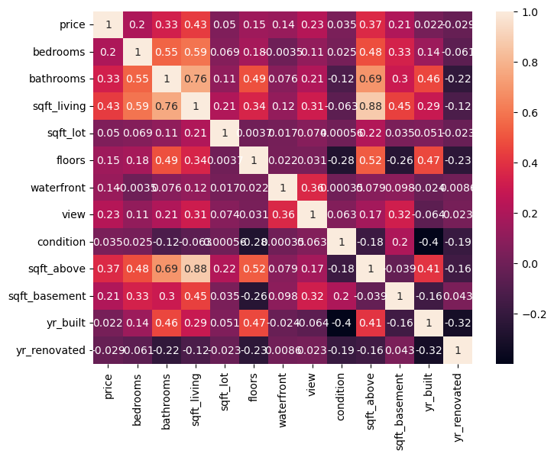
Exploratory Data Analysis (EDA)
This correlation heatmap provides a visual summary of the pairwise relationships between numerical features in the dataset. Each square shows the correlation coefficient between the variables on each axis. Correlation coefficients range from -1 to 1, where:1 indicates a perfect positive linear relationship, 0 indicates no linear relationship, -1 indicates a perfect negative linear relationship.
The variables with stronger correlations to price are potential candidates for features in our predictive model. However, caution must be taken with multicollinearity, as some of the variables are highly correlated with each other (e.g., sqft_living and sqft_above).

Slide 7
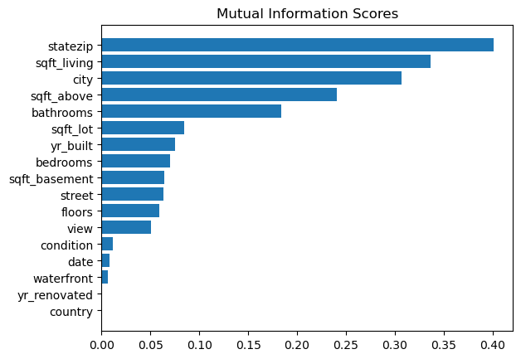
Feature Selection
Mutual Information (MI) Scores have been calculated to evaluate the relevance of various features with respect to the target variable, 'price'. MI scores provide a non-linear measure of dependency between variables, which is more general than correlation.
Key Insights from the MI Scores Bar Chart:
statezip: This feature has the highest mutual information score, suggesting that the location encapsulated by the zip code has a substantial impact on housing prices.
sqft_living: Living area size ranks high in mutual information, reinforcing the notion that larger homes tend to be valued higher.
city: Indicates the importance of the city as a feature, possibly due to differences in market dynamics across cities.

Slide 8
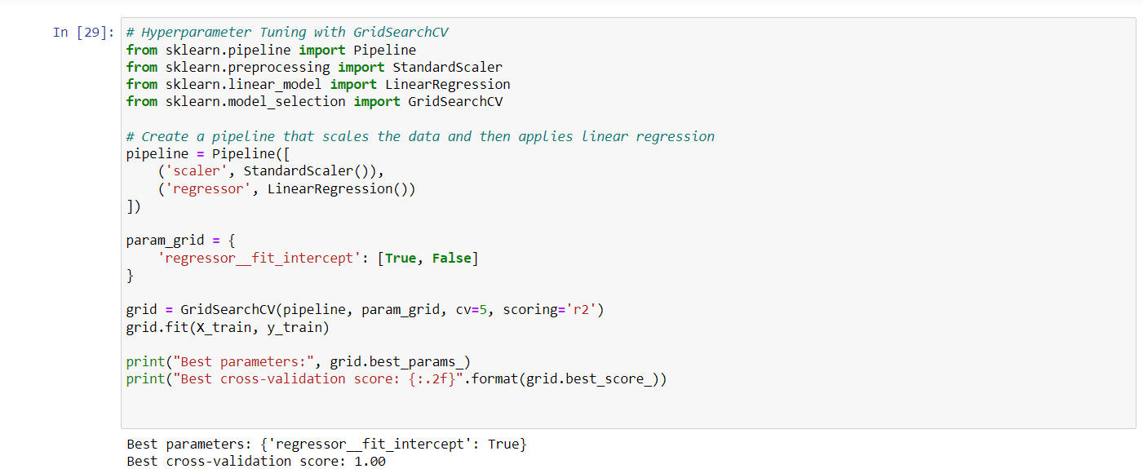
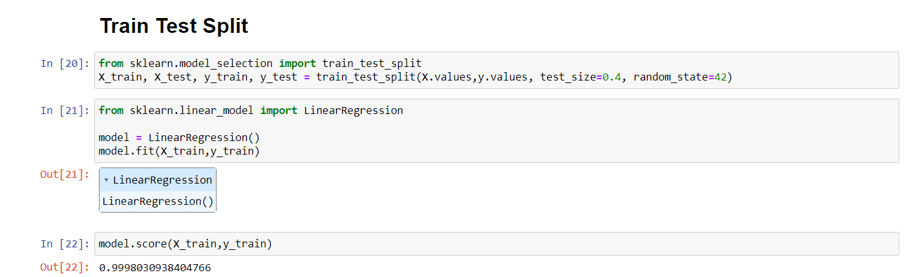
Model Training
Linear Regression Model:
Chosen for its simplicity and interpretability, linear regression fits a model with coefficients to minimize the residual sum of squares between the observed targets in the dataset and the targets predicted by the linear approximation.
Training Process:
A combination of encoding, scaling, and regression was used in a pipeline to ensure a robust approach to handling categorical features and feature scaling, and to facilitate the application of linear regression.
GridSearchCV was employed to fine-tune the model by systematically working through multiple combinations of parameter tunes, cross-validating as it goes to determine which tune gives the best performance.

Slide 9
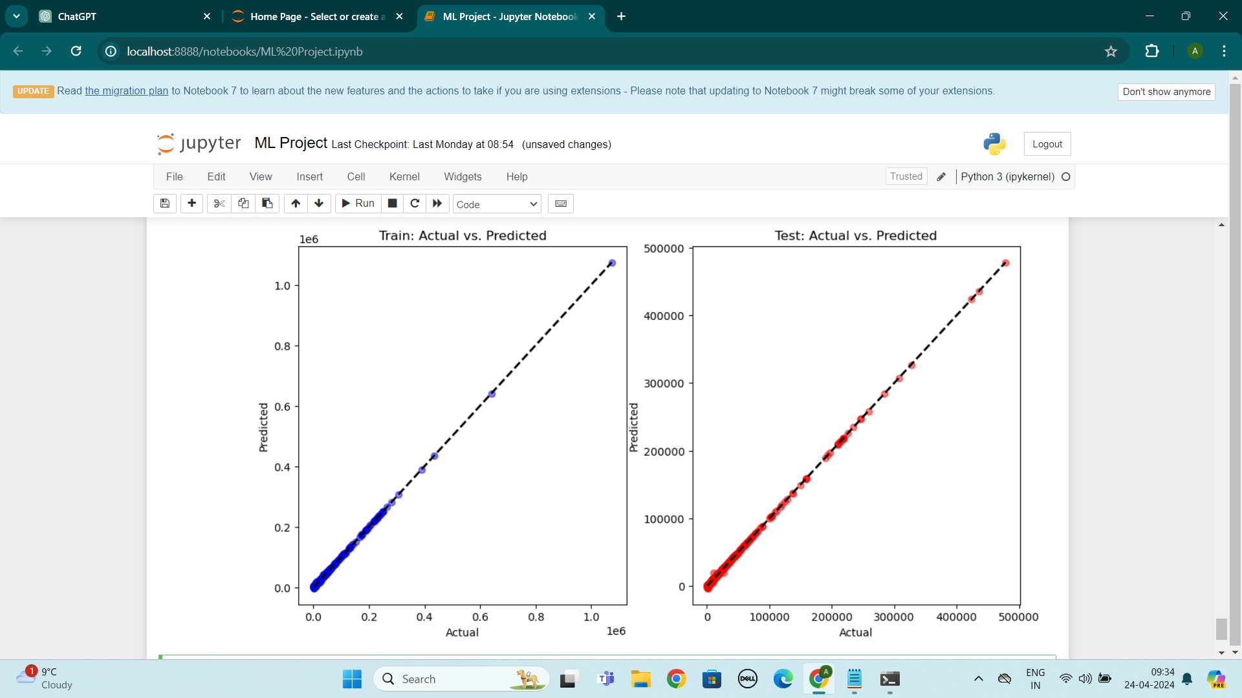
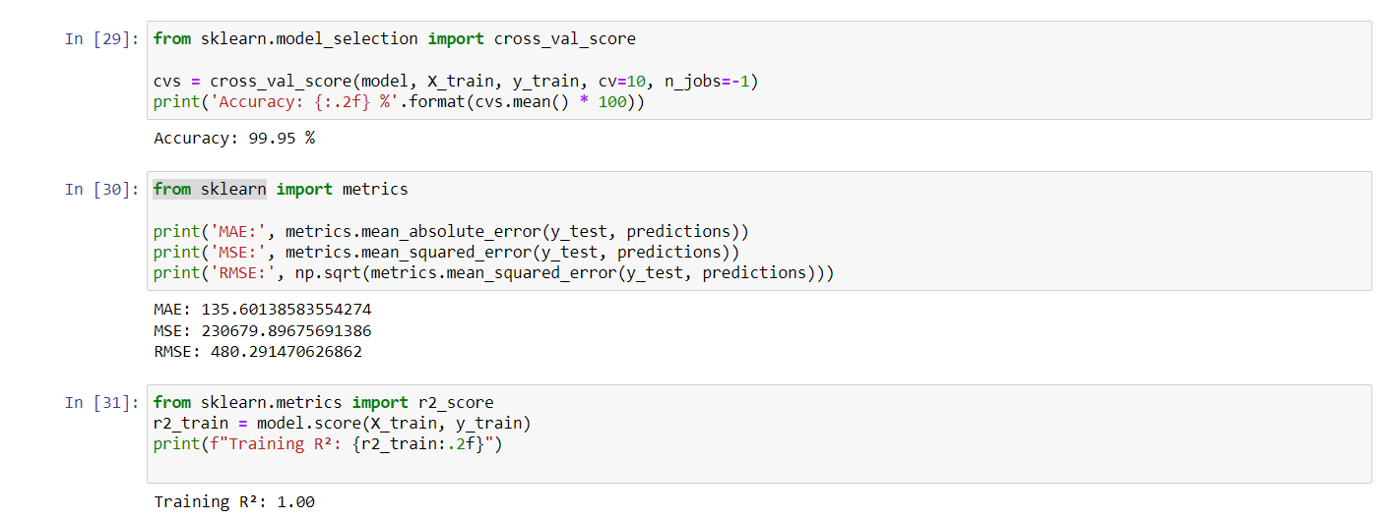
Model Evaluation
Performance Metrics Summary:
The model shows an impressive cross-validation accuracy of 99.95% on the training data, suggesting a very high level of fit.
However, the primary evaluation metrics on the test data indicate some errors:
MAE (Mean Absolute Error) is 135.60, which suggests that, on average, the model's predictions are about 135.60 units off from the actual prices.
MSE (Mean Squared Error) stands at 2,306,79.89, highlighting that there are variations in the prediction errors, and larger errors are heavily penalized due to squaring.
RMSE (Root Mean Squared Error) is 480.29, providing an error magnitude that is on the same scale as the price, thus easier to interpret.
Actual vs. Predicted Visualization:
The scatter plots show the actual vs. predicted prices for both the training and test sets, with a dashed line representing perfect predictions.
The plots reveal that the model predicts the training set perfectly, as indicated by a Training R² score of 1.00. However, this could be a sign of overfitting, where the model learns the training data too well but may not perform equally well on unseen data.
The test set's scatter plot suggests good predictive performance, but we must be cautious about the perfect training fit.

Slide 10
Conclusion
Main Findings:
The linear regression model demonstrated strong predictive capabilities with high cross-validation accuracy during training.
Evaluation metrics on the test data, such as MAE and RMSE, suggest that the model has a low average error in the context of the house pricing scale, assuming average house prices are high (e.g., around $500,000).
Model Insights:
The most informative features for predicting house prices were found to be 'statezip', 'sqft_living', and 'city', which is consistent with real estate market trends where location and property size are key determinants of price.
The high R² score on the training data indicates a potential overfitting issue, which is a valuable insight for future model development.
Future Work:
To improve the model, regularization techniques like Lasso or Ridge Regression could be implemented to mitigate any overfitting.
Additional feature engineering could be explored to enhance the model's ability to capture more complex relationships within the data.
Validation on a separate dataset or through more robust cross-validation techniques could be employed to confirm the model's generalizability.

Slide 11
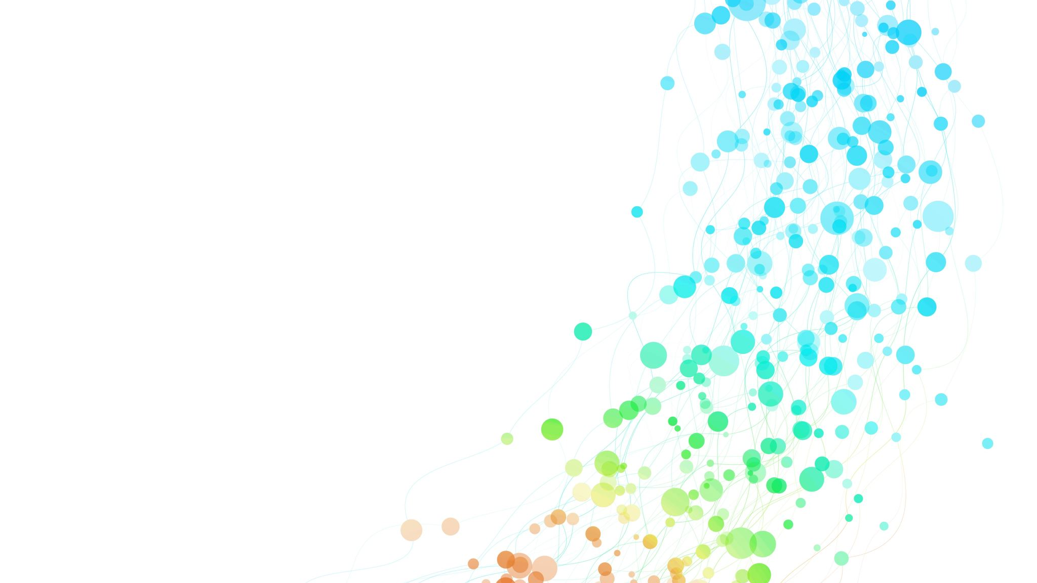
Thank You.
Questions ?

